Slide 1
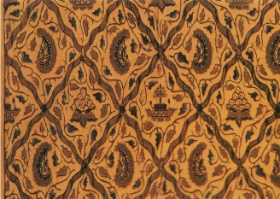
Batik
High School Painting and Drawing

Slide 2
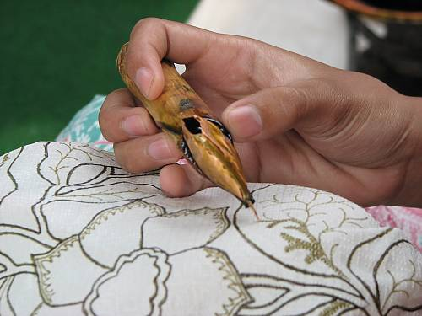
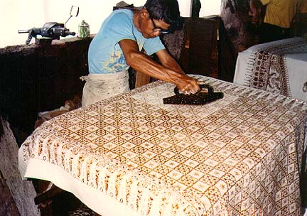
A What?????
A BATIK is a traditional Japanese cloth made using a wax-resist dying technique
Batik was originally made for religious purposes, using different colors to represent different Hindu gods
Patterns were utilized to determine social status. During Japanese ceremonies, nobility could be determined by evaluating the cloth a person was wearing

Slide 3
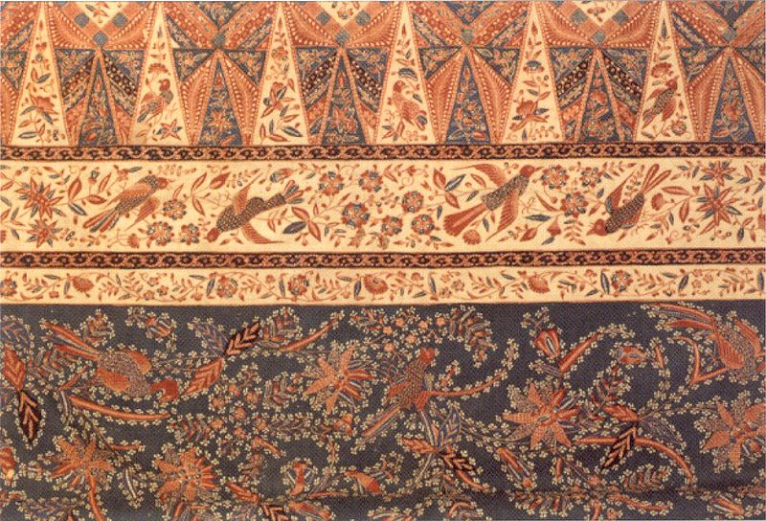

Slide 4
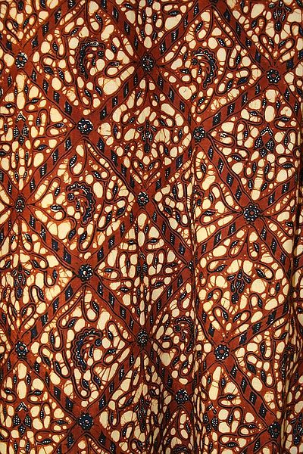
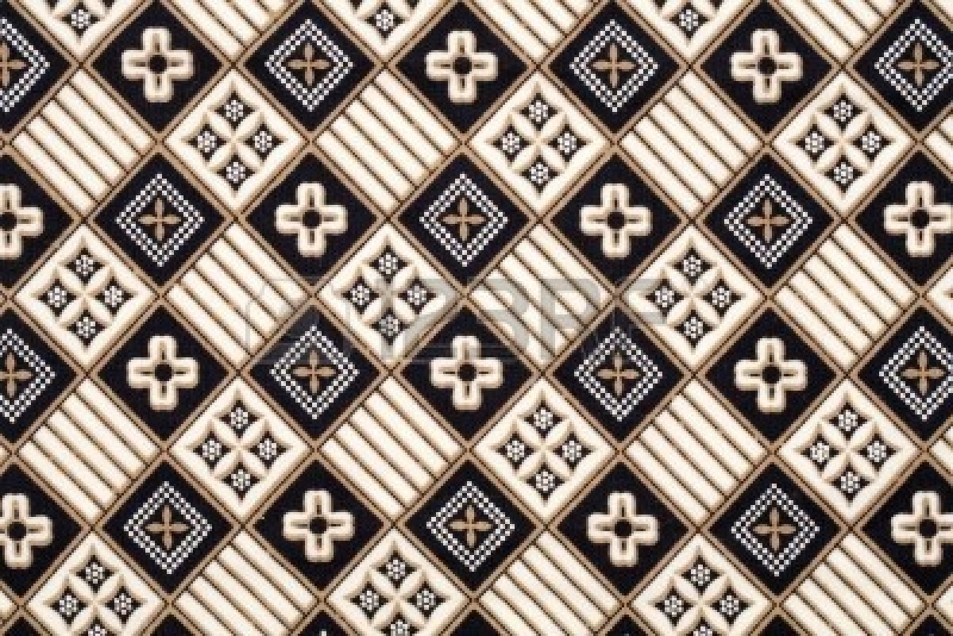


Slide 5
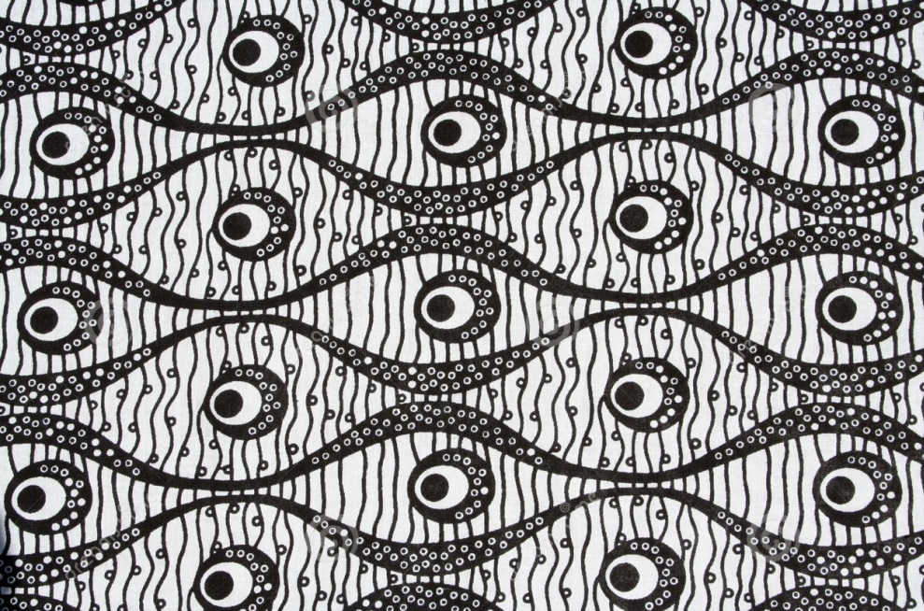
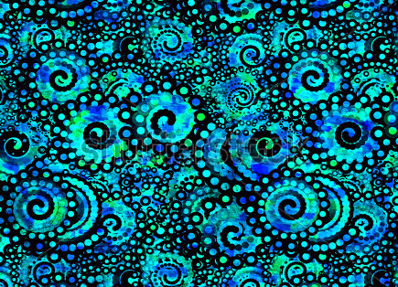
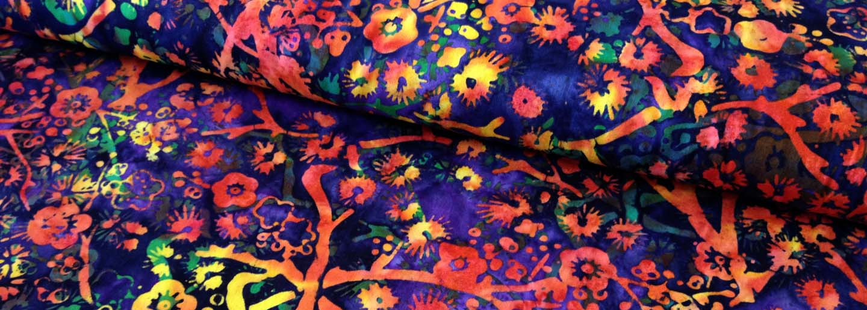

Slide 6
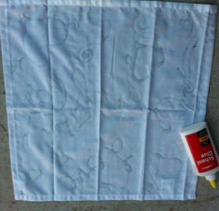
Instead of ____ We are using glue!
What might be some pros and cons of using glue instead of wax?

Slide 7
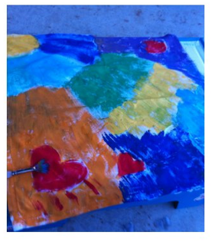
Then we will add acrylic paints on top of our fabric (after the glue has dried)
What art elements and principles of design should we consider when painting our fabric?

Slide 8
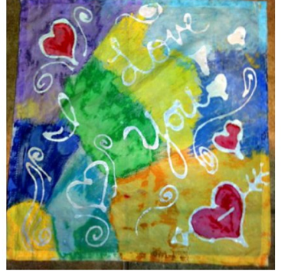
Where the glue was, is now white.
Our acrylic paints serve as a dye for our fabric, staining the fabric the color of the paint.

